Slide 1
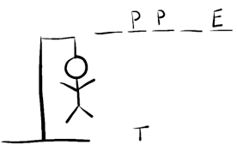
Hangman
Lets play !
Showing how hangman works in java script

